Slide 1
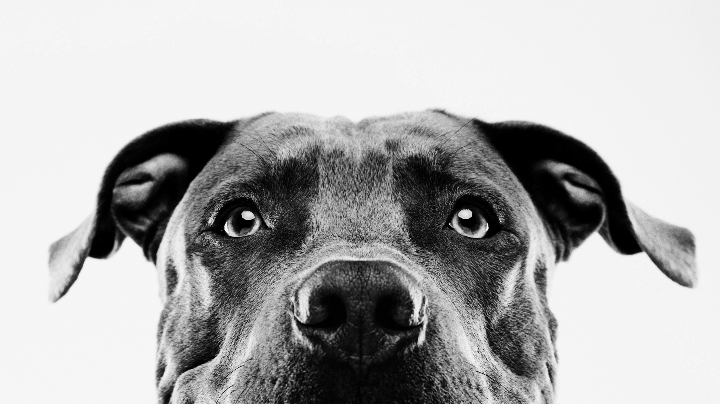
Projecting organic land use metrics for north america
Christopher “topher” de la rosa

Slide 2
Background and what is organic agriculture?
Popularity of shopping organic and adoption of organic agricultural practices
Some examples: no synthetic fertilizers and pesticides on produce
Livestock examples: only organic feed, no antibiotics or hormones

Slide 3
Organic agriculture is good for biodiversity
30% increased species richness
Percentage of landscape as arable fields increased

Slide 4
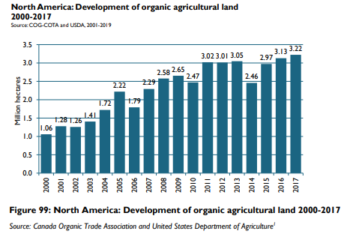
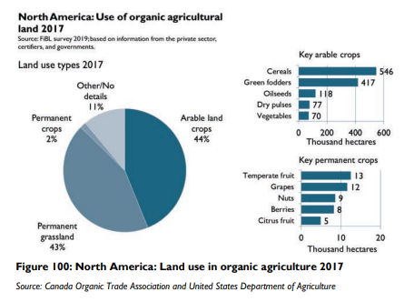
Data to be projected

